Slide 1
RESTful Web API Design
Rainer Stropek

Slide 2

RESTful
Software Architecture Summit 2015
Rainer Stropek
software architects gmbh
Web
Mail
Twitter
http://www.timecockpit.com
rainer@timecockpit.com
@rstropek
Web API Design

Slide 3
Agenda
RESTful Web APIs have become an integral part of modern software packages. They are important for integration scenarios in enterprises and in the cloud. This workshop is dedicated to designing RESTful Web APIs. Rainer Stropek, himself founder a SaaS-focused company, will guide you through the world of RESTful APIs. In particular, Rainer will speak about the following topics:
Short recap of the basic principles of RESTful Web APIs
Real-world RESTful API design (e.g. addressing in multi-tenant systems, versioning, long-running operations, etc.)
Authentication and authorization with OAuth2 and OpenID Connect
The OData standard for RESTful APIs
The role of metadata using the examples of http://swagger.io/ and OData
Securing and operating RESTful APIs using the example of Azure API Management
Code samples using Node.js with JavaScript and .NET with C#
Attendees of this workshop should have some understanding of http and cloud computing. Practical experience regarding RESTful API design or development is not necessary.

Slide 4
RESTful Web APIs
Short recap of the basic principles of RESTful Web APIs

Slide 5
What is „REST“?
Representational State Transfer (REST)
Architecture style, not a standard
HTTP
Request-response protocol in client-server systems
HTTP methods („verbs“)
GET – retrieve data, no side effects (except logging, caching, etc.)
HEAD – like get but without response body, useful to retrieve metadata
POST – submit new data
PUT – update or create
PATCH – partial update
DELETE
TRACE – echo
OPTIONS – query verbs that the server supports for a given URL

Slide 6
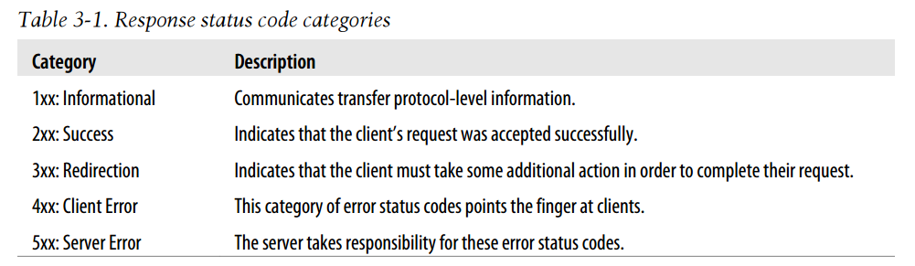
What is „REST“?
HTTP
Idempotent requests
GET, HEAD, OPTIONS, TRACE
PUT, DELETE
Non idempotent requests
POST
Status Codes (complete list of status codes), examples:
200 OK
201 Created
301 Moved permanently
400 Bad request
401 Unauthorized
403 Forbidden (authorization will not help)
404 Not found
405 Method not allowed (wrong verb)
500 Internal server error
Source of Table: Mark Massé, REST API Design Rulebook, O‘Reilly

Slide 7
What is „REST“?
HTTP
Header fields (list of header fields), examples:
Accept – e.g. application/json
Authorization – authentication credentials
Cache-Control
Cookie
Content-Type
If-Match, If-Modified-Since, If-Unmodified-Since
X-… - non-standard fields
ETag – identifier for a specific version of a resource
Last-Modified
Set-Cookie

Slide 8
What is „REST“?
Important REST principles
Stateless
No client context stored on the server, each request is complete
Cacheable
Responses explicitly indicate their cacheability
Layered System
Client cannot tell if connected directly to the server (e.g. reverse proxies)
URIs
Resources are identified using Uniform Resource Identifiers (URIs)
Resource representation
XML, JSON, Atom – today mostly JSON

Slide 9
RESTful Web API
Interacting with a RESTful web api
Tools
Azure Mobile Service
Fiddler
Postman

Slide 10
RESTful Web API
Create Azure Mobile Service
Show REST API documentation
Create table, allow all requests anonymously
Show POST, GET in Fiddler
Show POST, PATCH, DELETE, GET in Postman
Show table content in SQL Management Studio
Change access policy to API key
Get API key
Show GET with API key in X-ZUMO-APPLICATION header
Demoscript

Slide 11
API Design
Real-world RESTful API design

Slide 12
Design Rules
Do use HTTPS
No-brainer on public networks
Recommended on company/home network, too
Do use a consistent naming schema
Prefer hyphens (“-”) instead of underscores (“_”) in URIs
Do not mix languages
Prefer lowercase letters in URIs
Prefer camel casing for resource representation (e.g. in JSON)
Singular noun for documents, plural noun for collections, verb for controller names

Slide 13
Design Rules
Do carefully model URI paths
URIs should reflect the API‘s resource model
E.g. https://api.myservice.com/customers/ALFKI/orders
Bad example: https://api.myservice.com/afe7f2cb-8e71-4472-a53b-1f8e3712dffc/orders
Don’t forget controller resources
Consider identity values for variable URI path segments
E.g. https://api.myservice.com/customers/ALFKI/orders
Do use HTTP verbs as they were intended to
Also for controller resources (e.g. POST for controller that creates data)
Consider firewall problems with PUT and sometimes even DELETE
Avoid using controller names instead of HTTP verbs
Bad example: https://api/myservice.com/customers/deleteCustomer?id=ALFKI

Slide 14
RESTful Web API
Controller resources

Slide 15
RESTful Web API
exports.post = function(request, response) {
if (!request.body || !request.body.rows) {
response.status(400).end();
}
else {
var customerTable =
request.service.tables.getTable('customers');
for (var i = 0; i < request.body.rows; i++) {
var customer = {
firstName: "Test " + i.toString(),
lastName: "Test " + i.toString(),
revenueYTD: i * 1000
};
customerTable.insert(customer);
}
response.status(201).end();
}
};
Demoscript
Custom API

Slide 16
Design Rules
Do use standard response codes as they were intended to
200 for success
201 if somethings has been created (specify URI of new resource in Location header)
202 if controller started an async operation
204 if not response was sent back intentionally (PUT, POST, DELETE)
401 if something is wrong with authorization
404 if no resource is present at given URI
406/415 if requested/given Content-Type is not supported
500 represents a server error (not the client’s fault)
Consider returning additional error information in body
Use response code 4xx and error information in response body
Don’t expose security-critical data in error messages (especially for server errors)
Use properly protected logs instead

Slide 17
API Design
Location header with POST
Additional error data in case of 4xx error

Slide 18
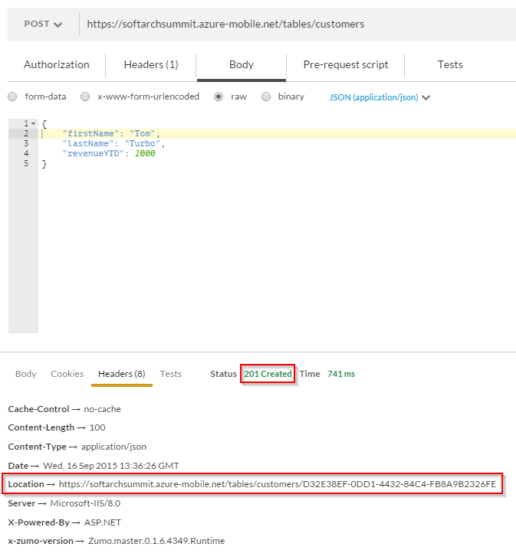
RESTful Web API
Demoscript
Location header

Slide 19
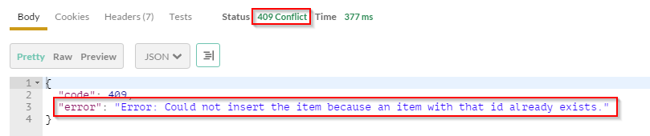
RESTful Web API
Demoscript
Additional error data

Slide 20
Design Rules
Don’t use GET + query for controller actions that write
Use proper HTTP verbs and parameters in the request body instead
Do use query for ad hoc filtering, sorting, paging, etc.
Examples:
https://api.myservice.com/customers?$filter=name eq ‘ALFKI’
https://api.myservice.com/customers?$top=10
https://api.myservice.com/customers?$orderby=name
http://petstore.swagger.io/v2/pet/findByStatus?status=sold
See also OData (more details later)
Consider allowing correlation identifier in custom header
Stored in server-side logs
Can be used to correlate client- and server-side activities

Slide 21
Design Rules
Consider support for batching of operations
Performance considerations (latency reduction)
Execute in server-side transactions
Example: Entity Group Transactions in Azure Table Storage
Consider using Multipart MIME messages
Example: OData Batch Requests
Consider allowing the client to specify a server timeout
Do define a maximum server timeout to protect from over-usage of server resources
Consider progress reporting for long running requests
Examples: Polling API, Message bus, SignalR

Slide 22
Design Rules
Consider using Etag and If-None-Match to save bandwidth
Consider using If-Match or If-Unmodified-Since for optimistic concurrency
Consider allowing to suppress response echo on POST
Typically, POST returns created document
Consider a header with which the client can suppress this echo to save bandwith

Slide 23
API Design
Location header with POST
Additional error data in case of 4xx error
Building Web API with Node.js
Prefer header in Azure Table Storage

Slide 24
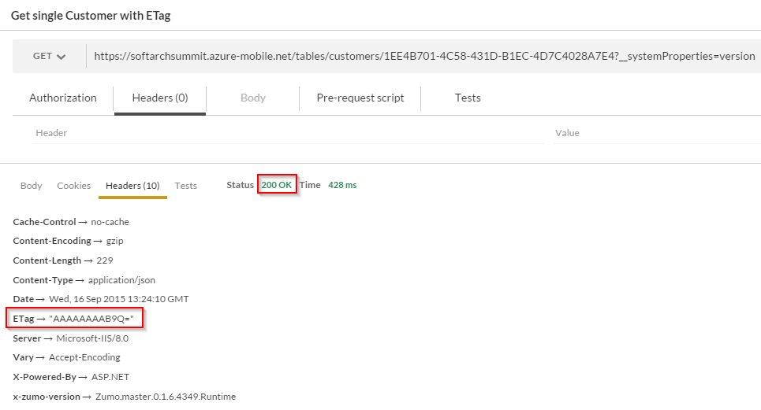
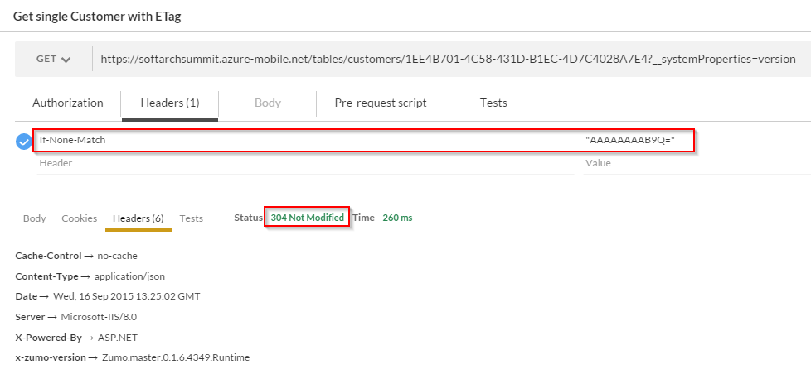
RESTful Web API
Demoscript
ETag and If-None-Match

Slide 25
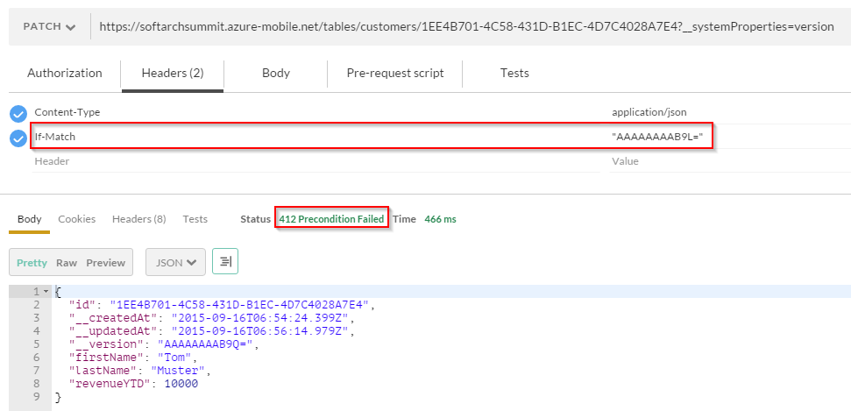
RESTful Web API
Demoscript
If-Match and optimistic concurrency

Slide 26
Design Rules
Do support JSON for resource representation
application/json
Consider other resource representation if needed
E.g. application/xml
Consider adding links
Programmatically process connections between resources
Consider publishing schema information
For details see OData and Swagger

Slide 27
API Design
Links for entities in OData XOData

Slide 28
Design Rules
Consider configuring CORS to enable broad web API usage
Don’t solely rely on CORS for protecting your resources
Avoid JSONP (JSON with padding)
Work around same origin policy by injecting <script> tags at runtime
Do use OAuth2 and OpenID Connect to protect resources
See also Protecting Resource section later for more details

Slide 29
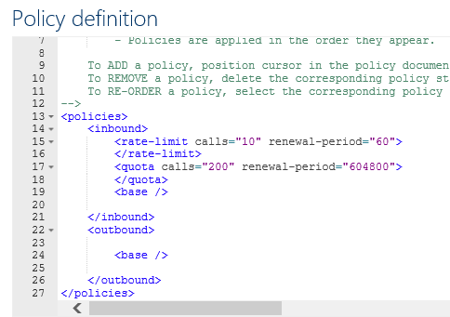
Design Rules
Do limit server resource usage in multi-tenant systems
Examples:
Query timeout and pagination in Azure Table Storage
API rate limits in Azure API Management

Slide 30
Design Rules
Do plan for versioning your web API
Consider using a custom header for API version to enable complex versioning scenarios
Examples
x-ms-version in Azure Table Storage
OData-MaxVersion and OData-Version headers in Odata
Consider using version-specific URIs for simple versioning scenarios and major versions

Slide 31
Protecting Resources
CORS – Cross-Origin Resource Sharing

Slide 32
What is CORS?
XMLHttpReqest limits cross-domain web API calls
Same origin policy: Script can only make HTTP requests to the domain it came from
CORS is a W3C spec to allow cross-domain calls
See http://enable-cors.org/client.html for browser support
Server specifies allowed calling domains in special response headers
See Mozilla Docs for technical details about CORS
https://developer.mozilla.org/en-US/docs/Web/HTTP/Access_control_CORS

Slide 33
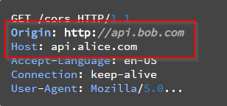
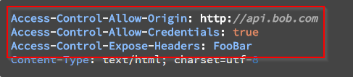
How CORS works
Simple requests
GET, HEAD or POST
If POST, only content types application/x-www-form-urlencoded, multipart/form-data, or text/plain
No custom headers in the request
Browser sends Origin header
Server returns error if Origin in not allowed to do API calls
Access-Control headers
Allow-Origin: * or Origin
Allow-Credentials: Cookies included?
Expose-Headers: Non-simple headers available to the client

Slide 34
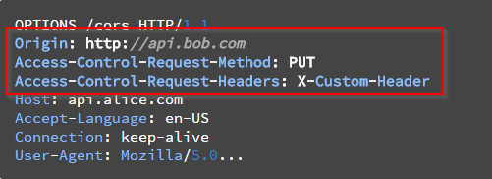
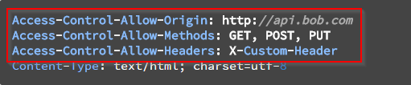
How CORS works
Non-simple requests
Preflight request
Client asks for permissions
Server must support OPTIONS
Performance implications
Server returns no CORS headers if not allowed
Actual request follows successful preflight request

Slide 35
CORS
Adding CORS support to ASP.NET Web API

Slide 36
RESTful Web API
Add NuGet package Microsoft.AspNet.WebApi.Cors
public static void Register(HttpConfiguration config)
{
// New code
config.EnableCors();
}
--- or ---
[EnableCors(origins: "http://example.com",
headers: "*", methods: "*")]
public class TestController : ApiController
{
// Controller methods not shown...
}
Demoscript

Slide 37
Protecting Resources
Auth with OAuth2 and OpenID Connect

Slide 38




Local Auth
Enterprise
Auth inside of the enterprise
Single, integrated domain
All devices belong to the enterprise
Everything is Windows
Problems
External devices
External services
Non-Windows environments
Workstations
Servers
Domain
Devices

Slide 39
OAuth2
Successor of OAuth1 and OAuth WRAP
Standard for delegating authorization for accessing resources via HTTP(S)
Not a standard for authentication
Not a standard for authorization
Very common in the internet today
Many different flavors as the standard leaves many decisions up to the developer
Example: https://oauth.io/

Slide 40
Important Terms
OAuth Provider
Aka OAuth Server, Authorization Server
Examples: AD FS, Google, Twitter, Microsoft AAD
Resource Provider
Aka Resource Server
In our case: A REST Web API
Resource Owner
In our case: The end user, the organization
Client
Application accessing a protected resource
In our case: Native app, server-based web app, SPA, mobile app

Slide 41
OAuth Endpoints
Authorization Endpoint (aka OAuth-A)
Authenticates the resource owner (e.g. user/password)
Asks for consent
Sends confirmation (access code) to redirect endpoint
Redirect Endpoint
Offered by the client
Called via redirecting the user-agent (HTTP redirect 302)
Receives code (there are other options, too) and fetches token from token endpoint
Token Endpoint (aka OAuth-T)
Creates tokens for access codes, refresh tokens, etc.
Can validate the client using a client secret

Slide 42
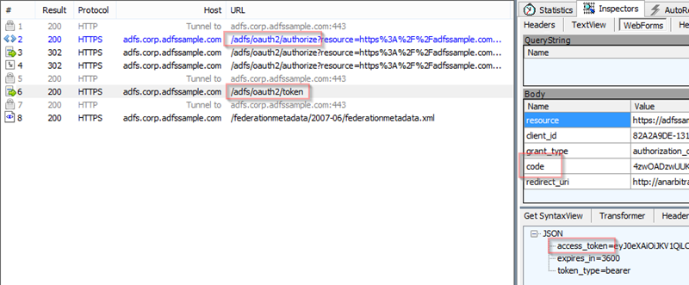
OAuth Tokens
Authorization Code
Access Token
Refresh Token

Slide 43
OAuth Flows
Authorization Code Flow
Aka 3-legged OAuth
Client must be capable of storing secrets
Implicit Flow
Less secure
No refresh tokens
For clients that cannot store secrets (e.g. SPA written in JavaScript)
Resource Owner Password Flow
For trusted clients
Client Credential Flow
Aka 2-legged OAuth
Client is also the resource owner

Slide 44
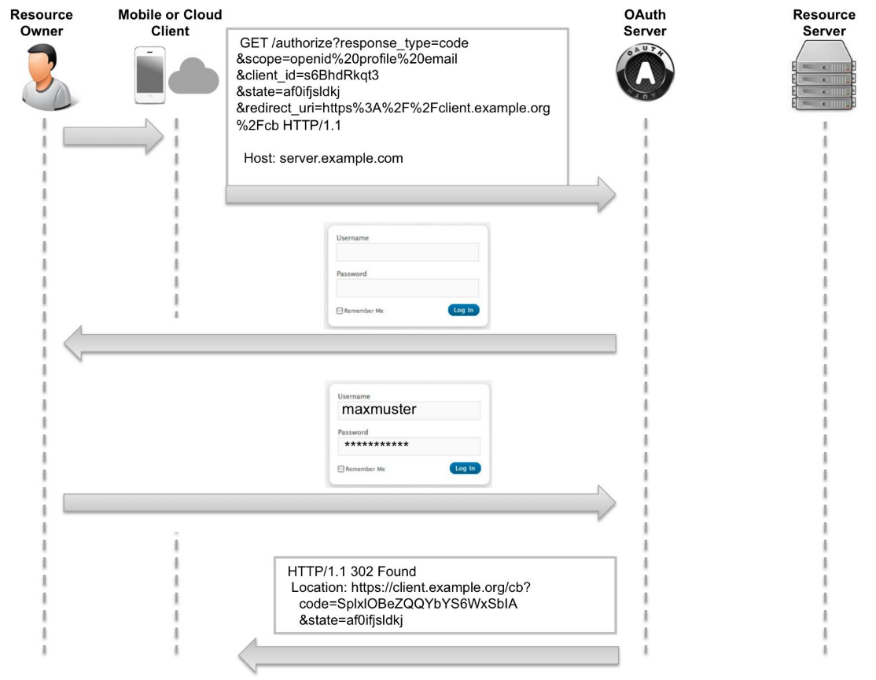
Authorization Code Flow
Getting the auth code
Source: Biehl, Matthias (2014-11-14). OAuth 2.0: Getting Started in API Security (API-University Series Book 1)

Slide 45
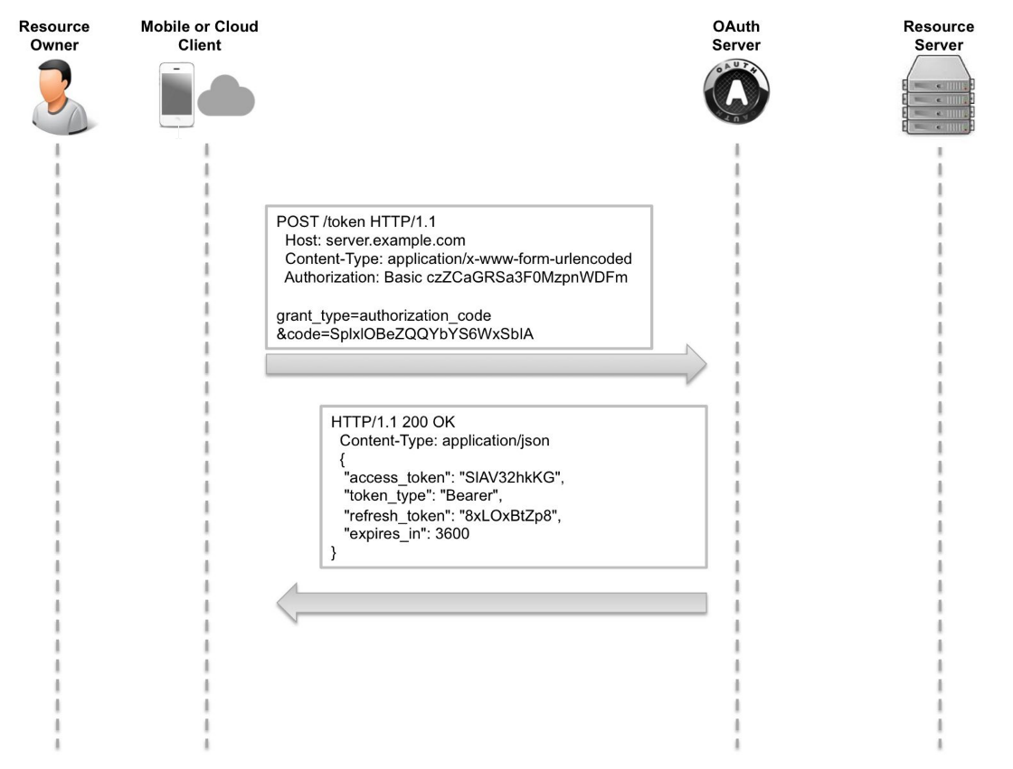
Authorization Code Flow
Getting the token
Source: Biehl, Matthias (2014-11-14). OAuth 2.0: Getting Started in API Security (API-University Series Book 1)

Slide 46
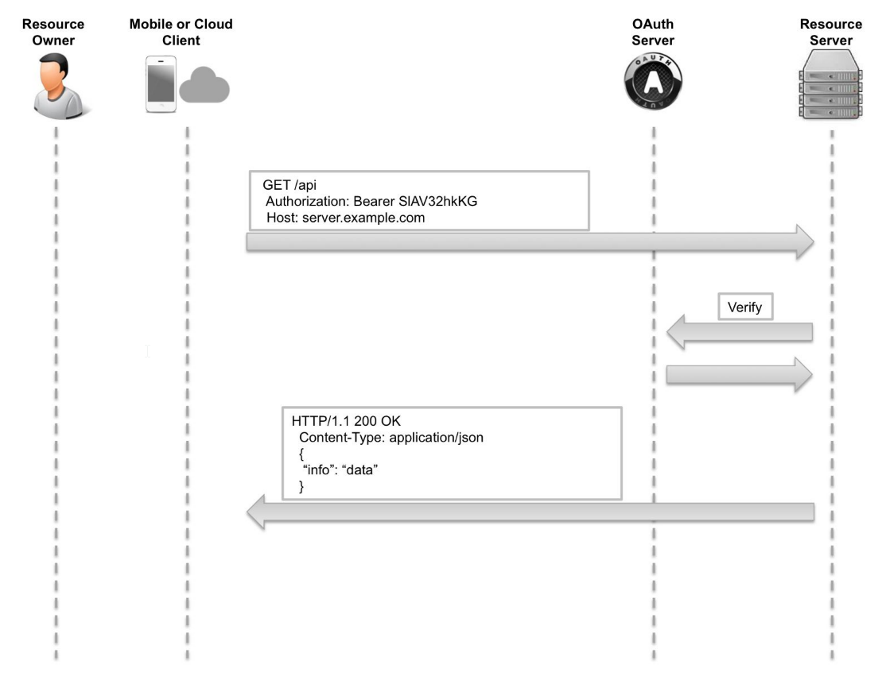
Authorization Code Flow
Accessing the resource
Source: Biehl, Matthias (2014-11-14). OAuth 2.0: Getting Started in API Security (API-University Series Book 1)

Slide 47
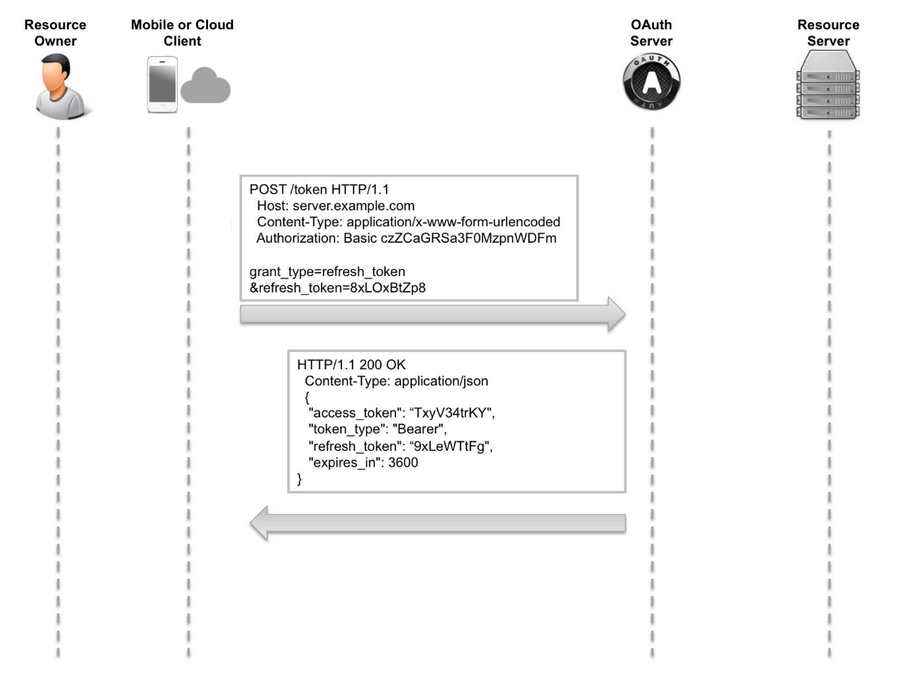
Authorization Code Flow
Refreshing the token
Source: Biehl, Matthias (2014-11-14). OAuth 2.0: Getting Started in API Security (API-University Series Book 1)

Slide 48
Problems with OAuth2
Many different implementations
Not compatible
Limited scope
No specified token formats, crypto algorithms, etc.
No standard for authN, session management, etc.
No specification for token validation
Open ID Connect fills many of the gaps
Standardized way to get the resource owner’s profile data
Introduces an ID-Token
Standardized token format and crypto: JWT (JSON Web Token)

Slide 49
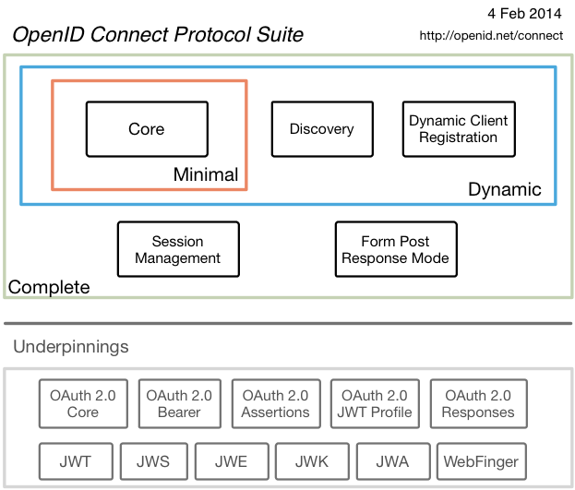
OIC Protocol
OpenID Connect extends OAuth2
Although rather new, OIC is already very popular
Libraries and products: http://openid.net/developers/libraries/
Source: http://openid.net/connect/

Slide 50


Delivering a seamless user authentication experience
Active Directory
Microsoft Azure
Identity Synchronization with password hash sync
User attributes are synchronized using Identity Synchronization services including a password hash, Authentication is completed against Azure Active Directory
Identity Synchronization
Microsoft Azure
User attributes are synchronized using Identity Synchronization tools, Authentication is passed back through federation and completed against Windows Server Active Directory
Source: http://channel9.msdn.com/events/TechEd/Europe/2014/CDP-B210
AD FS

Slide 51
Standards based integrations
Custom LOB applications that integrate with Azure Active Directory
Sign in to Active Directory-integrated applications with cloud identities
Active Directory-integrated applications can access Office 365 and other web APIs
Applications can extend Azure Active Directory schema
Cross-platform support
iOS, Android, and Windows
Open Standards
SAML, OAuth 2.0, OpenID Connect, OData
OAuth2 &
OpenID Connect
SAML
WS-Federation
REST based Graph API
Microsoft Azure
Active Directory
SCIM
Source: http://channel9.msdn.com/events/TechEd/Europe/2014/CDP-B210

Slide 52
Web API Metadata
The role of metadata using the examples of http://swagger.io/ and OData

Slide 53
Why Metadata?
Humans and computers discover and understand services
Less need to read documentation or source code
Enables tools for the API creator
Write less documentation manually
Make consuming the API easier → raises adoption
Enables tools for the API consumer
Build generic service consumer
Examples: BI tools like PowerBI, workflow engines like Azure Logic Apps
Auto-generate client code/libraries

Slide 54
Swagger
http://swagger.io
Tools for API creators
Swagger Editor (http://editor.swagger.io/) for top-down approach
Auto-generate Swagger definition from server-side implementation
Example: https://github.com/domaindrivendev/Swashbuckle
Tools for API consumers
Swagger UI (http://petstore.swagger.io/)
Code generators (http://swagger.io/getting-started/swagger-codegen)

Slide 55
Swagger
Swagger editor
Swagger code generator (AngularJS)

Slide 56
OData – Much More than Metadata
http://www.odata.org
Common Schema Definition Language (CSDL)
OASIS standard
Extensible
http://docs.oasis-open.org/odata/odata/v4.0/odata-v4.0-part3-csdl.html
Libraries for API creators and consumers
http://www.odata.org/libraries/
Widely used at Microsoft and SAP
Examples: Microsoft Azure, PowerBI, Visual Studio

Slide 57
OData – Much More than Metadata
CRUD operations
RESTful web API
Standardized query language using URIs
https://api.myserver.com/odata/Customers? $filter=CustomerID eq 15& $top=10& $select=FirstName,LastName
http://docs.oasis-open.org/odata/odata/v4.0/odata-v4.0-part2-url-conventions.html
Standardized document representation
XML (Atom), JSON
http://docs.oasis-open.org/odata/odata-json-format/v4.0/odata-json-format-v4.0.html

Slide 58
OData
Implementing an OData service in .NET
OData consumption
XOData
Power BI

Slide 59
Q&A
Software Architecture Summit 2015
Rainer Stropek
software architects gmbh
Mail Web Twitter
rainer@timecockpit.com http://www.timecockpit.com @rstropek
Thank your for coming!

